Slide 1

Choosing The Right Processor for your Embedded System Design
DAY 2
EMBEDDED SYSTEM DESIGN & IoT-Master Class

Slide 2
What You will learn Today?
Difference between Mp/Mc DSP,CPLD,FPGA and SoC
Selection of Packages
Processor Selection Criteria
Hardware Design Flow
Software Design Flow
Simulation , Evaluation and Emulation

Slide 3
Day 2 Choosing the Right Processor for Embedded System Design

Slide 4
Mindset Lesson for the Day
Rebooting Your Brain
Exercise 1 – Write down everything that you can think of that you need to do
Exercise 2- Write down everything that you can think of that you want in your life that currently you don’t have
Exercise 3- Write down everything that you can think of that you are afraid of or worry about .next to each one make a note of what a worst case scenario would be

Slide 5
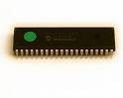

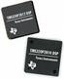
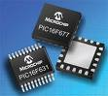
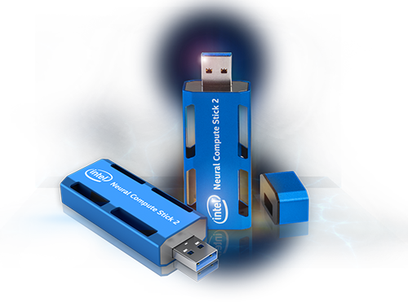
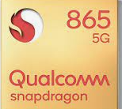
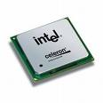
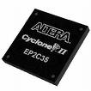
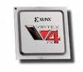
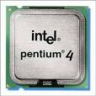
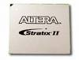
Types of Processors and Controllers
Texas,analog devices,Motorolla,
Dallas,philips
Renesas,freescale,
Texas,Microchip
DSP
Microprocessors/
Microcontrollers (8/16/32)
SOC
QUALCOMM
BROADCOMM
ASIC
GENERAL PURPOSE
PROCESSORS
(CPU Vs GPU)
CPLD/FPGA
INTEL
Xilinx,Altera
Lattice,Actel
Intel,AMD,Nvidia

Slide 6
Microprocessor Basic
CPU
CONTROL
ADDRESS
DATA
BOOT ROM
Used at startup
Instruction (program) ROM
Transducers
Keyboard Screen UART Parallel interface
etc
Data RAM
Microprocessor, must have external peripherals to
Interact with outside world,It is obsolete

Slide 7
Micro controller
CPU
Program Memory
Timers
Data Memory
ADC
UART
Parallel Port
CAN

Slide 8
Basic Features of DSPs
Digital Signal Processor is mathematics on chip.
DSPs usually run applications with hard real-time constraints:
DSPs usually process infinite continuous data streams.
MAC Capability
DSP processors are microprocessors designed for efficient
mathematical manipulation of digital signals.

Slide 9
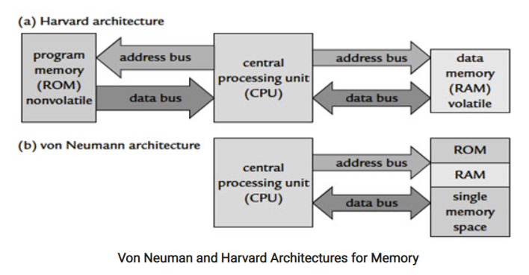
Why do we need DSP processors?
Microcontrollers are control oriented ,DSP are data path oriented
Use a GPP processor when the following are required:
Large memory.
Advanced operating systems.
Use a DSP processor when the following are required:
Precision
Cost saving.
Smaller size.
Low power consumption.
Processing of signals in real-time.

Slide 10
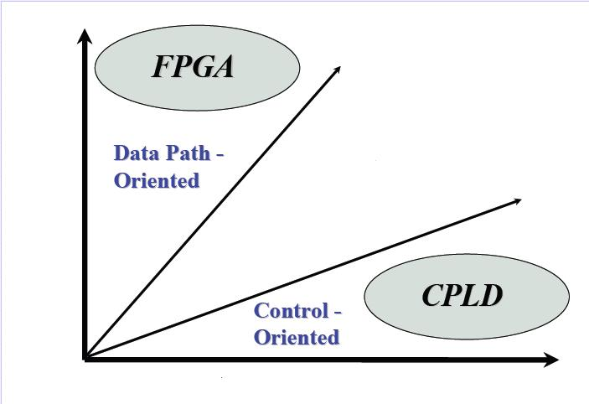
CPLD Vs FPGA

Slide 11
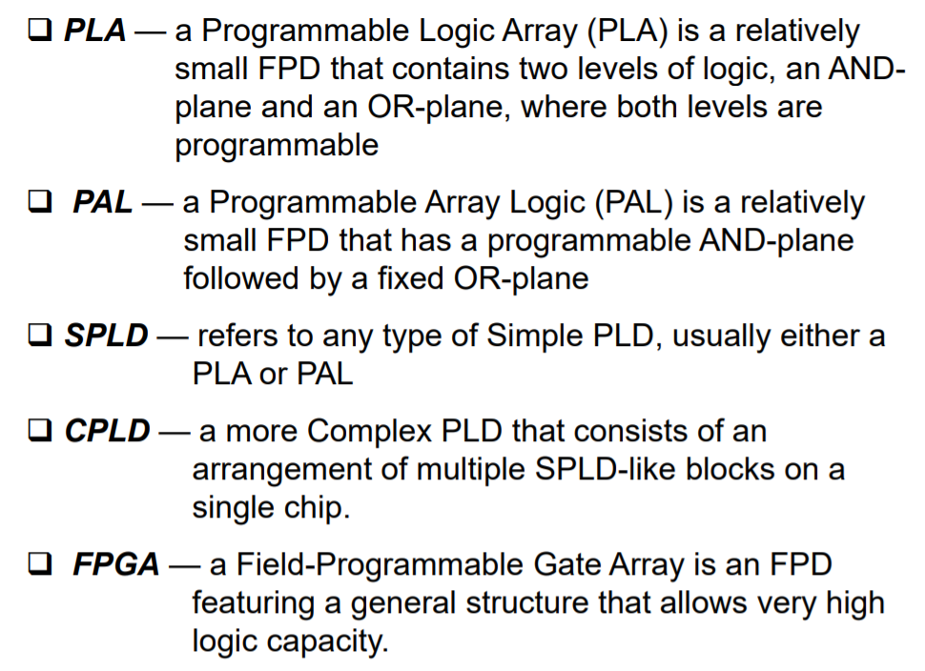
Diff between PLA,PAL,PLD,CPLD and FPGA

Slide 12
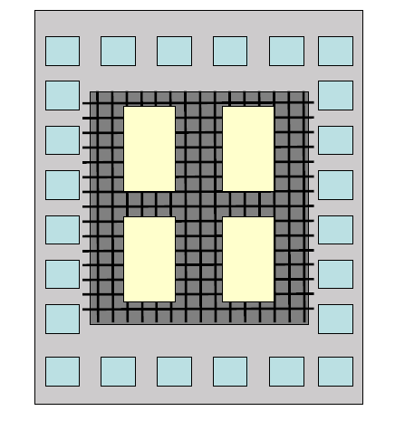
CPLD Architecture
Logic blocks
I/O blocks
Clock routing
Routing matrix

Slide 13
FPGA Architecture
Logic blocks
I/O blocks
Clock routing
Routing matrix
Memory
Multipliers /DSP blocks
Processor core

Slide 14
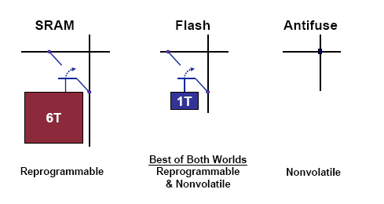
FPGA Technologies

Slide 15
DSP Vs FPGA

Slide 16
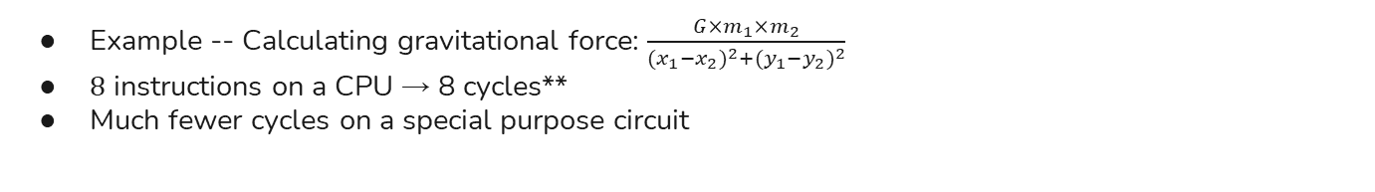
Fine-Grained Parallelism of Special-Purpose Circuits
Example -- Calculating gravitational force: $\frac{G×m_{1}×m_{2}}{{(x_{1}−x_{2})}^{2}+{(y_{1}−y_{2})}^{2}}$
8 instructions on a CPU → 8 cycles**
Much fewer cycles on a special purpose circuit
A = G × m₁
C = x₁ - x₂
E = y₁ - y₂
A = G × m₁ × m₂
B = (x₁ - x₂)²
C = (y₁ - y₂)²
B = A × m₂
D = C²
F = E²
D = B + C
G = D + F
Ret = B / G
3 cycles with compound operations
Ret = B / G
4 cycles with basic operations

Slide 17
When to use DSP in FPGA
Higher Performance
Parallel algorithm implementation
Customizable Design
Optimize for speed and cost
System Integration
Less board real estate
Less chips could mean less system cost

Slide 18
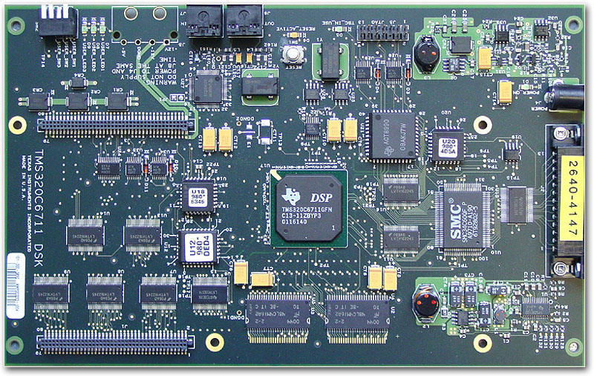
Traditional embedded system design using DSP
Power Supply
Ethernet MAC
CLK
Audio Codec
CLK
GP I/O
Interrupt Controller
Timer
Address Decode Unit
CPU (uP / DSP)
UART
Co- Proc.
LC
Memory Controller
custom IF-logic
CLK
SRAM
SRAM
SRAM
Display Controller
SDRAM
SDRAM

Slide 19
Next Step...
Power Supply
Ethernet MAC
CLK
Audio Codec
CLK
FPGA
GP I/O
Interrupt Controller
Timer
Address Decode Unit
CPU (uP / DSP)
UART
Co- Proc.
LC
Memory Controller
custom IF-logic
CLK
SRAM
SRAM
SRAM
Display Controller
SDRAM
SDRAM

Slide 20
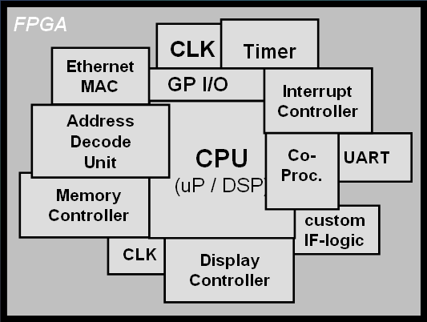
Configurable system on Chip-CSoC
Audio Codec
EPROM
Power Supply
LC
SRAM
SRAM
SRAM
SDRAM
SDRAM

Slide 21
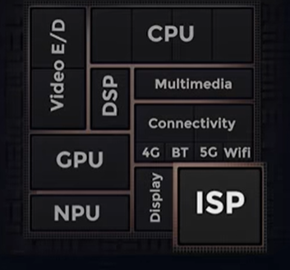
Multicore Processor -SoC
2 or More Independent Processors in 1 Package
Symmetric Multiprocessing
Number of Identical Processors
Common Shared Memory
One Operating System
Asymmetric Multiprocessing
Different Processors, Instruction Sets
Different Operating Systems
Possibly Without Shared Memory

Slide 22
AMP-TI OMAP
Processors Need Not be Identical
Processor Specialization May Increase Performance.
T.I.’s OMAP•General Purpose Processor+Digital Signal Processor(“DSP”)

Slide 23
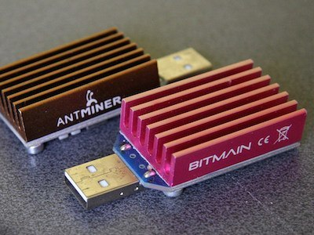
How FPGA Is Different From ASICs
ASIC (Application-Specific Integrated Circuit)
Special chip purpose-built for an application
E.g., ASIC bitcoin miner, Intel neural network accelerator
Function cannot be changed once expensively built
+ FPGAs can be field-programmed
Function can be changed completely whenever
FPGA fabric emulates custom circuits

Slide 24
Comparison
FPGA
ASIC
Cost
SOC
DSP
Micro controllers
Performance

Slide 25
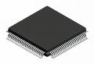
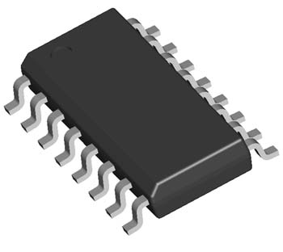
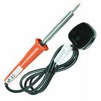
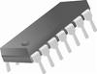
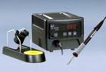
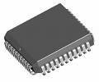
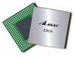
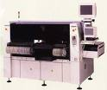
Selection of packages
SOLDERING
IRON
DIP
QFP
SOIC
SOLDERING
STATION
BGA
PLCC
OVEN

Slide 26
Processor selection Criteria
Development tools
Number of I/O’s
Performance
Cost
Operating systems
Hardware tools
Peripherals
Power consumption
Supplier reputation

Slide 27
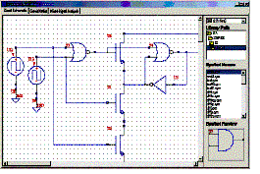
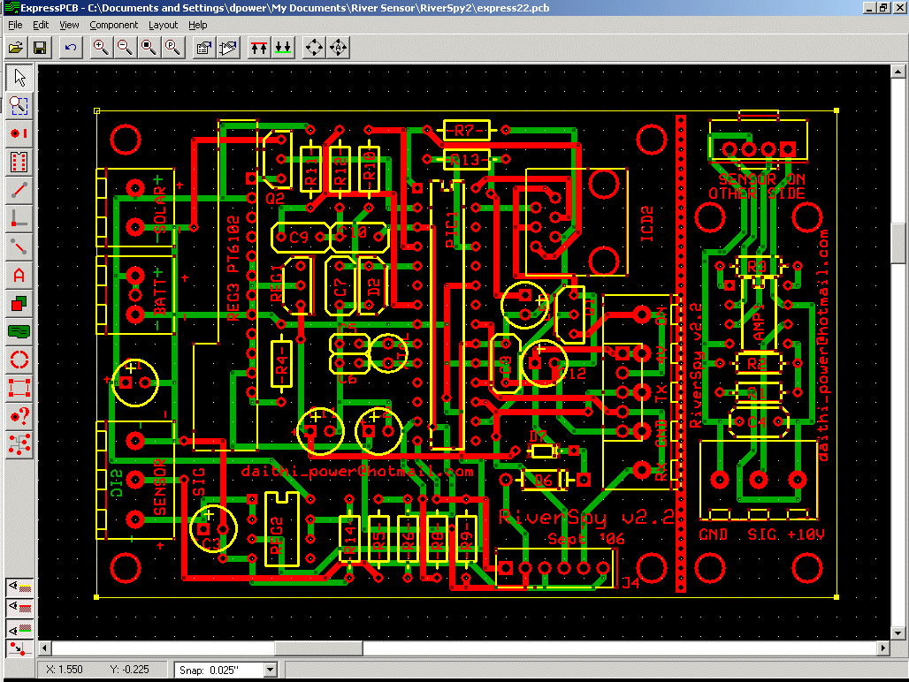

Hardware Design Flow
SCHEMATIC DESIGN
LAYOUT DESIGN
ASSEMBLY & TESTING

Slide 28

Schematic Design Consideration
Power supply design (Webench designer TI)
Use Ground Splitting if the Design contains any analog Parts(High speed ADC and DAC)
Proper Calculation of Decoupling Capacitors for VCC
ESD protection Diodes for esd sensitive IC’s

Slide 29
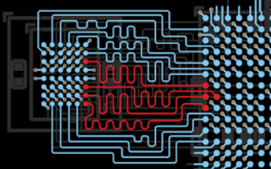
Layout Design Considerations
Check Footprints
Placement of Components as per schematics
Placement of decoupling capacitors close to VCC
Length Matching for High Speed Memories
Avoid Right angle traces during routing
Place High speed memory close to the Processor

Slide 30
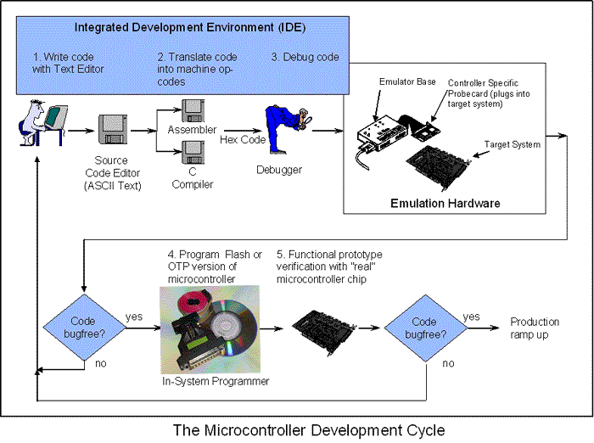
Software Design Flow

Slide 31
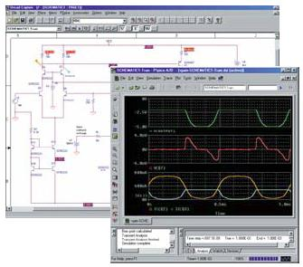
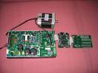
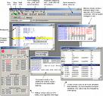
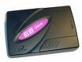
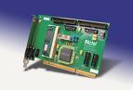
Simulation
Evaluation
Emulation

Slide 32
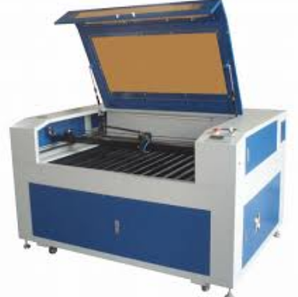
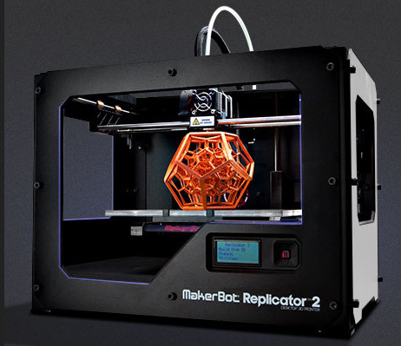
Cabinet design
Laser cutting CNC
3D Printer

Slide 33
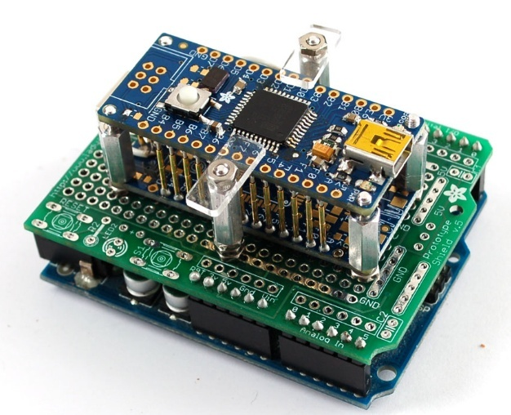
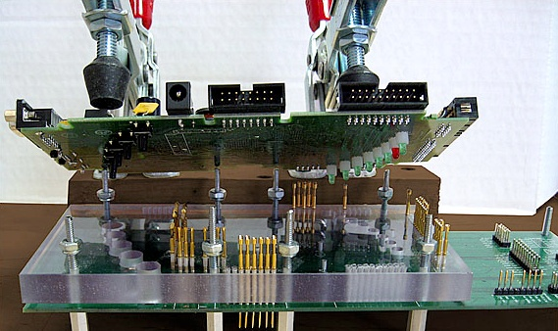
Test JIG

Slide 34
Recap of Designing an Embedded System
Choose Idea
Decide application, Features,
cost of the product
Select the right processor
and packages
C/ASM/GRAPHICAL
Design and fabricate PCB
Components Assembly
Integration
Testing

Slide 35
Thank You

